Slide 1


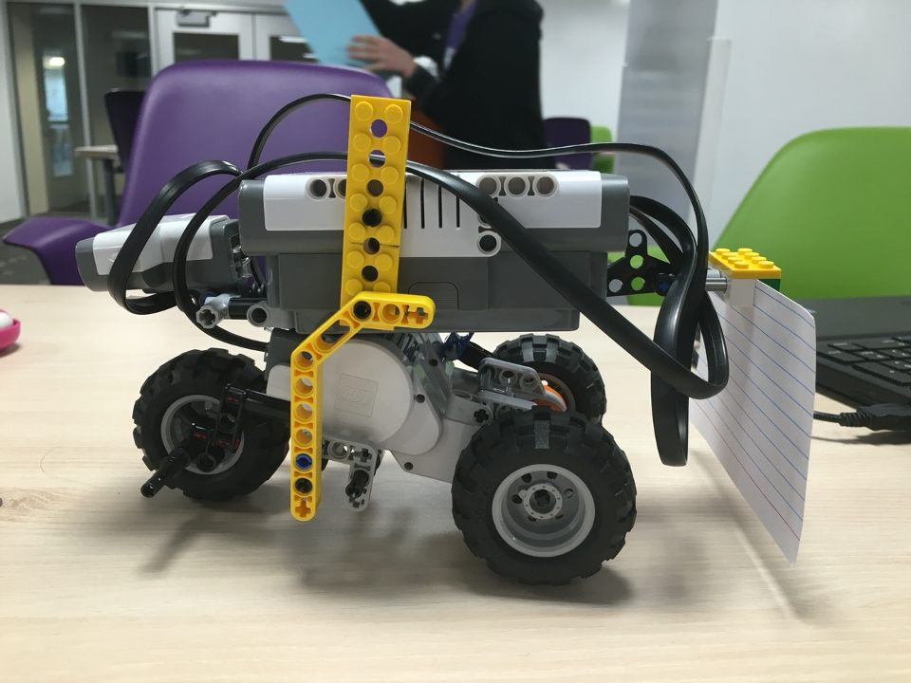
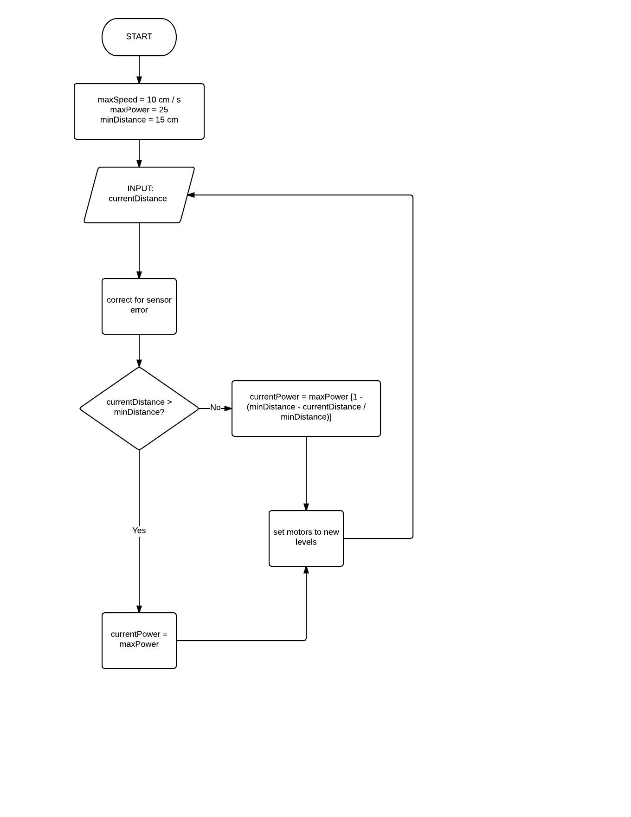
Development of an Autonomous Car
Kathryn Atherton, Joshua Hahn, Hannah Mackin Schenck
Purdue University, Purdue College of Engineering
Background
Design Process & Testing
Final Design & Performance
Autonomous control of cars has been vision of engineers
Currently, cruise control allows for control of speed
Driver still needs to monitor distance from other cars and facilitate passing of other vehicles
Sensors allow for proximity warnings when another car is passing in blind spots and may even apply brakes, if needed
Still no perfectly “autonomous” vehicle
Grand Challenge of Engineering to enhance mass transit in urban areas.
The design team began by making a flowchart of the logic required to meet all of the criteria for the vehicle, as seen in the bottom left corner.
Then, testing began to determine the accuracy of the sensors, mainly the ultrasonic sensor.
Simultaneously, the robot parts were analyzed to brainstorm the structure of the vehicle.
As the vehicle does not need to turn, only one motor was needed to operate the vehicle.
Due to the limited building resources, only one front wheel was incorporated into the design, and the vehicle has a rear-wheel drive design.
Various placements of the ultrasonic sensor were considered, but the team determined that having it in the very front over the front wheel was the best position for its function.
An equation was derived to determine the power required to operate the vehicle at various distances from the car ahead of it.
Finally, a code was created from the flow chart and equation, and a framework for the final car design was built.
The final design consisted of a single front wheel, with rear wheel drive.
The ultrasonic sensor was placed at the front of the vehicle and an index card was placed on the back so as to provide a surface for the vehicles behind it to sense its presence.
Immediately prior to testing, team had problems with the ultrasonic sensor controlling the deceleration of the vehicle
During the final performance, the vehicle continued to have this problem.
Criteria
ULTRASONIC SENSOR TESTING
Trial Number | Distance Sensed (cm) | Actual Distance (cm) | Change (cm)27
1 | 27 | 24 | 3
2 | 24 | 20 | 4
3 | 24 | 15 | 9
4 | 13 | 10 | 3
5 | 23 | 17 | 6
6 | 12 | 8 | 4
7 | 22 | 15 | 7
8 | 14 | 10 | 4
9 | 18 | 14 | 4
Monitor speed and distance of vehicles
Maintain vehicle speed limit of 10cm / sec
Maintain buffer distance of 15 cm between vehicles
Minimize correction times (< 1 second)
Never surpass 10 cm/s
Logic Flowchart
Conclusions
In order to improve this prototype, the design team recommends improving the ultrasonic sensor implementation.
The placement of the sensor should be tested again in order to maximize its functionality.
The battery level affects the power of the motors, so the power needs to be constantly adjusted in order to maintain the speed limit.
Otherwise, the three-wheeled vehicle design worked well and the vehicle was structurally sound.
MOTOR SPEED TESTING
Trial Number | Motor Speed | Robot Speed (cm/s)
1 | 50 | 21.0
2 | 30 | 13.6
3 | 20 | 5.97
4 | 25 | 11.5
Acknowledgments
We would like to thank our professor, Dr. Nauman, and Graduate TA, Michael, for their guidance and support throughout this process.

